Slide 1
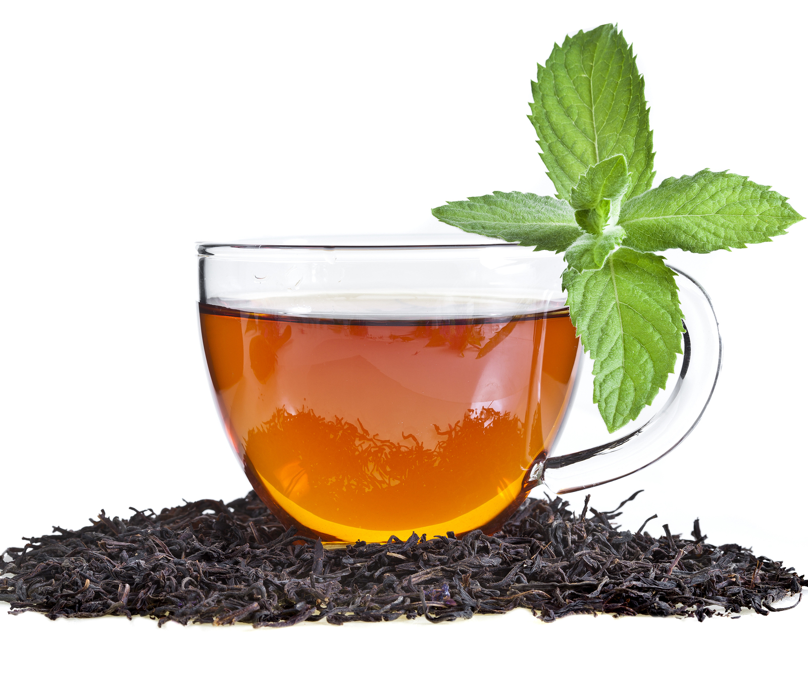
Tea Leaves Disease Prediction using CNN
Name: Kalyan Chakravarthy Yarraguntla
Registration Number: 21BAI1759
Faculty : Dr.Palani Thanaraj
Course: Machine Vision

Slide 2
Introduction
Tea Leaves Disease Prediction
This project aims to address the critical challenge of early detection of tea leaf diseases through the implementation of a deep learning model. The conventional methods of disease detection, primarily reliant on visual inspection, have proven to be time-consuming and prone to inaccuracies. In response to this,This project proposes the development and deployment of a deep learning model based on a Convolutional Neural Network (CNN). This model is designed to identify various diseases affecting tea leaves efficiently and accurately. By leveraging a labelled dataset of tea leaf images encompassing both healthy and diseased specimens, the CNN will be trained to distinguish and categorize different types of diseases. The overarching goal is to streamline the detection process, providing a reliable tool for tea farmers to identify and mitigate diseases promptly.

Slide 3
In this Project we mainly Detected the Healthy Leaves and Leaves with Diseases mainly 'Anthracnose’,’ algal leaf', 'bird eye spot', 'brown blight', 'Gray light', 'healthy', 'red leaf spot', 'white spot'
This project aims to predict tea leaves diseases using Convolutional Neural Networks (CNN) using Transfer Learning Method from VGG16 Pretrained Model. It includes a web interface built with Flask for user interaction, and a Google colab(ipynb) for the model development. The dataset used for training and testing the model is also included

Slide 4
Objective
Tea Leaves Disease Prediction
This project aims to revolutionize tea leaf disease detection by implementing a specialized deep learning model. Addressing limitations of conventional methods, the model focuses on subsets of diseases like fungal or bacterial infections, utilizing hyperspectral imaging for additional insights. A user-friendly mobile app or web platform ensures easy integration into daily farming operations. The social impact is substantial, reducing crop losses, improving tea quality, and increasing income for farmers, fostering sustainability in the tea industry. Incorporating transfer learning enhances scalability by initializing model weights with pre-trained data, expediting development and enabling adaptation to diverse datasets and new disease types.

Slide 5
This project aims to achieve the following:
Improved disease detection: By leveraging deep learning and hyperspectral imaging, the model will surpass conventional methods in accuracy and efficiency of disease detection.
Focus on high-impact diseases: Targeting fungal and bacterial infections, which are significant threats to tea crops.
Enhanced user experience: A user-friendly mobile app or web platform will make the model accessible and easy to implement in daily farming operations.
Positive social impact: Reducing crop losses, improving tea quality, and increasing farmer income will contribute to the sustainability of the tea industry.
Scalability through transfer learning: By initializing the model with pre-trained data, development time is reduced, and the model can be adapted to diverse datasets and the identification of new disease types in the future.

Slide 6
Related work and its limitations
Tea Leaves Disease Prediction
Referance paper 1 : https://ieeexplore.ieee.org/document/10263835
Reference paper 2 : https://ieeexplore.ieee.org/document/10169680
Reference paper 3 : https://ieeexplore.ieee.org/document/9155850

Slide 7
The existing problem revolves around the inefficiencies and limitations inherent in traditional methods of tea leaf disease detection. Current practices, primarily reliant on visual inspection, prove to be time-consuming and prone to inaccuracies. These shortcomings contribute to delayed responses in identifying and addressing diseases, leading to increased crop losses. The urgency of adopting a more advanced and efficient solution is evident, prompting the development of a deep learning model specialized in tea leaf disease detection.
Complex machine learning models can be difficult to interpret, making it challenging for farmers to understand the underlying reasons for prediction results.
The accuracy of tea leaf prediction models relies on the quality and quantity of data used to train them. Insufficient or biased data can lead to inaccurate predictions.
Tea leaf diseases manifest differently depending on environmental factors, making it challenging to develop universally applicable prediction models.
Tea leaf prediction models may generate false positives, leading to unnecessary interventions and resource expenditure.

Slide 8
Dataset and its attributes
Tea Leaves Disease Prediction
Data set : Identifying Disease in Tea leaves (kaggle.com)
This tea sickness dataset contains tea leaves showing 7 common diseases of tea:
Red leaf spot
Algal leaf spot
Bird’s eyespot;
Gray blight;
White spot;
Anthracnose;
Brown blight.

Slide 9
Each image is digitally represented, allowing for computational analysis. Augmentation techniques, including rotation, shifting, and flipping, are applied during training to diversify the dataset and enhance model generalization. Additionally, preprocessing steps such as rescaling and normalization ensure standardized pixel values across the dataset.
Images are resized to a target size of (224, 224) pixels, accommodating the input dimensions required by deep learning models. During training, images are processed in batches, with a batch size of 20 chosen to balance computational efficiency and model stability. These attributes collectively provide a robust foundation for training and evaluating deep learning models for automated tea leaf disease detection.

Slide 10
Proposed Methodology
Tea Leaves Disease Prediction
The proposed methodology encompasses several key steps aimed at improving the accuracy of Tea leaf disease detection from leaf images. These steps include preprocessing and exploratory data analysis, followed by the implementation of a deep learning model based on the VGG19 architecture with custom layers. Below is an elaboration of each component:
Development Environment Setup
Dataset Gathering & Preprocessing
Data Augmentation
Model Training (Training and Evaluation) VGG19
Testing
Integration with Web Interface
Deployment as API or Web Service

Slide 11
Enabling the training of the selected deep learning model using the preprocessed dataset.Implement monitoring tools to assess the model's performance on the validation set during training. And support the adjustment of hyperparameters to optimize model performance. Integrate data augmentation techniques
By adopting this approach, we expect the proposed deep learning model, built upon VGG19 with additional custom layers, to achieve superior accuracy in detecting tea leaf diseases from high-resolution images. Through meticulous image pre-processing, in-depth data exploration, thorough model training, and rigorous evaluation, the model can offer valuable insights for diagnosing tea leaf diseases. This, in turn, can significantly improve farm management practices and decision-making, leading to better crop health and yield.

Slide 12
Preliminary Results
Tea Leaves Disease Prediction
The collection of a diverse dataset containing labeled examples of both healthy and diseased tea leaves.
Data Preprocessing:
Implement functionality to standardize image sizes for consistent input to the deep learning model.
Enhancing image quality through normalization and noise reduction.
Division of the dataset into training and validation sets for model evaluation.
Integrating data augmentation techniques such as rotation and flipping during model training to enhance its ability to recognize disease patterns
Thorough evaluation of the model on a separate test dataset provides a reliable estimate of its performance in real-world scenarios. Computing performance metrics such as accuracy, precision, recall, and F1-score ensures comprehensive assessment of the model's capabilities.

Slide 13
Tea Leaves Disease Prediction
with the proposed deep learning model achieving an testing accuracy of more than 95%. This increase in accuracy underscores the effectiveness of the methodology employed, particularly the incorporation of the VGG19 architecture with custom layers.
This model uses a convolutional neural network (CNN) to identify diseased tea leaves in new images with high accuracy. The model was trained on a dataset of labelled tea leaf images, including images of healthy leaves and leaves with different types of diseases. which helps in The advantages stemming from early disease detection, precision in crop protection strategies
Overall, this project represents a positive step toward a more efficient, sustainable, and technologically integrated approach to tea farming.

Slide 14
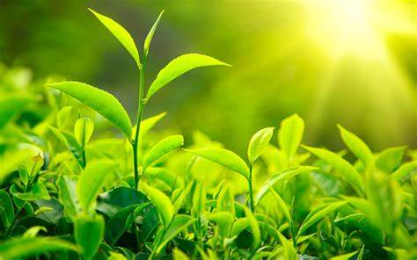
Thank you
Dr.Palani Thanaraj
21BAI1759

